Slide 1
GENERAL PHYSICS I
PART B

Slide 2
OUTLINE
SYSTEM OF PARTICLE
CENTRE OF MASS
ROTATIONAL MOTION
TORQUE
VECTOR PRODUCT
MOMENT
ROTATION OF COORDINATE AXES AND ANGULAR MOMENTUM,
POLAR COORDINATES
CONSERVATION OF ANGULAR MOMENTUM
CIRCULAR MOTION

Slide 3
SYSTEM OF PARTICLE CENTRE OF MASS
This is the point the point where the total mass of the body appears to act.
For rigid bodies, centre of mass is independent of the state of the body, i.e. whether it is in rest or in accelerated motion centre of mass will remain same.

Slide 4
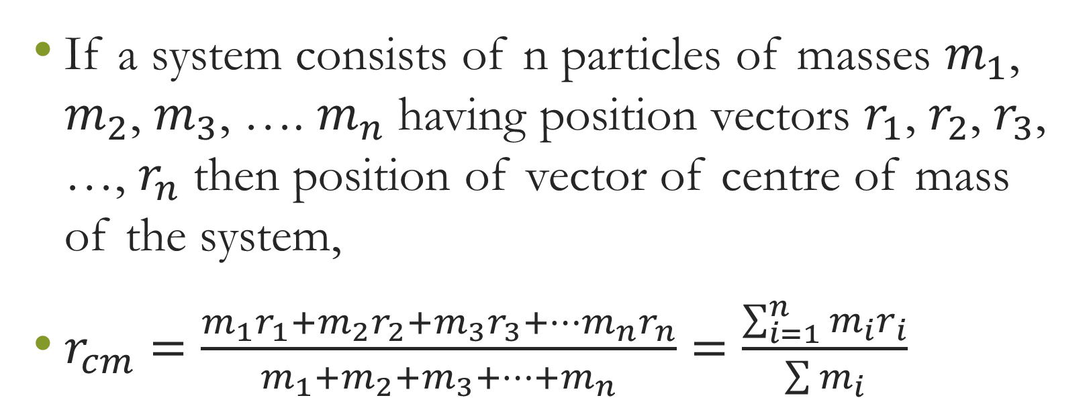
Centre of Mass of System of n Particles

Slide 5
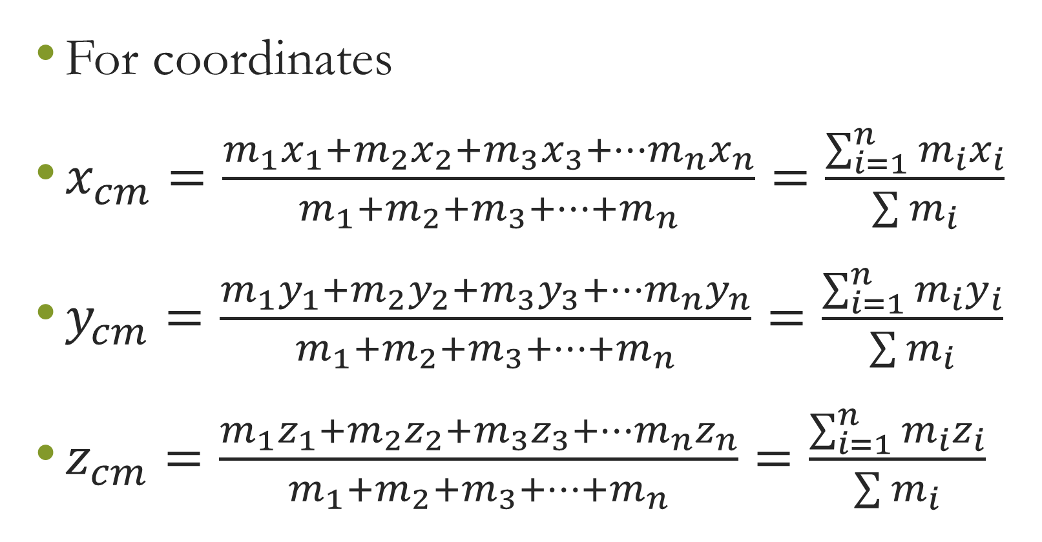

Slide 6
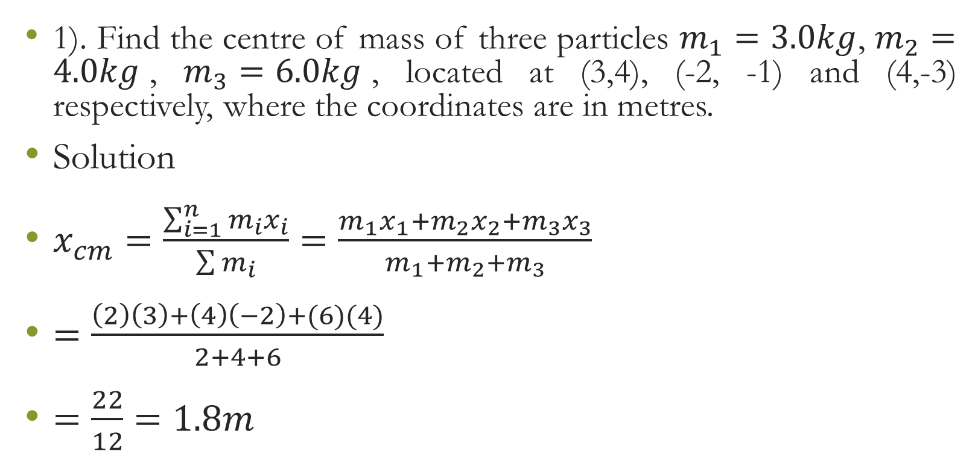
Examples

Slide 7
ROTATIONAL MOTION
This is the motion of a body in circular path at a fixed point.
A rigid body is a body having a definite shape and made of many particles which are at fixed distance from each other. Example of a rod, ruler and molecules in atomic scale.

Slide 8
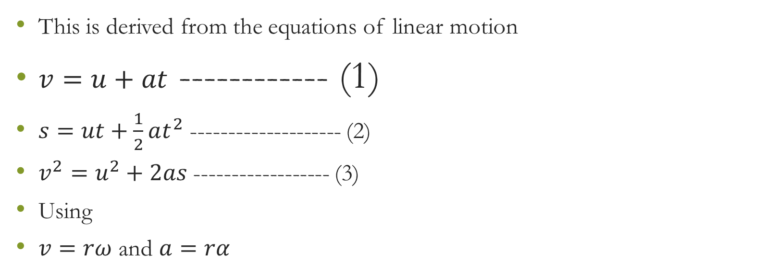
EQUATIONS OF ROTATIONAL MOTION

Slide 9
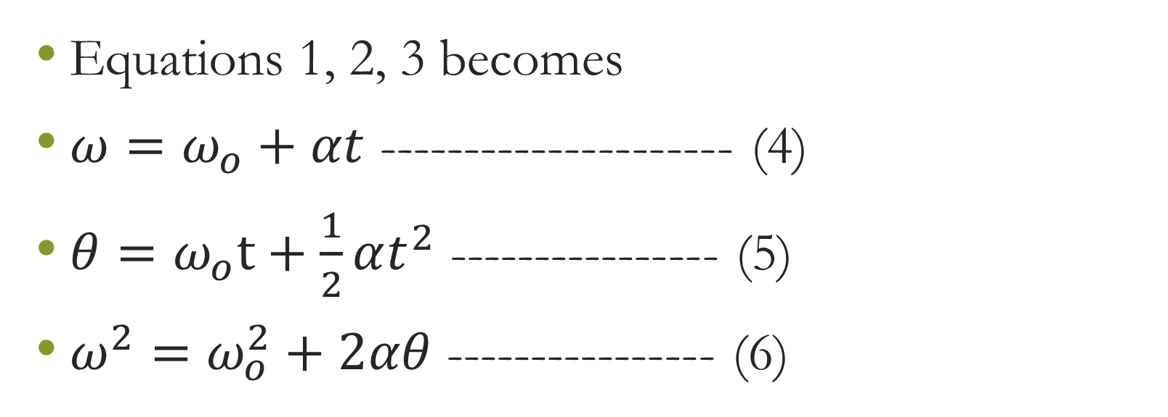

Slide 10
EXAMPLES
Deep-sea fisherman hooks a big fish that swims away from the boat pulling the fishing line from his fishing reel. The whole system is initially at rest and the fishing line unwinds from the reel at a radius of 4.50 cm from its axis of rotation. The reel is given an angular acceleration of 110rads/s for 2.00 s.
(a)What is the final angular velocity of the reel?
(b) At what speed is fishing line leaving the reel after 2.00 s elapses?
(c) How many revolutions does the reel make?
(d) How many meters of fishing line come off the reel in this time?

Slide 11
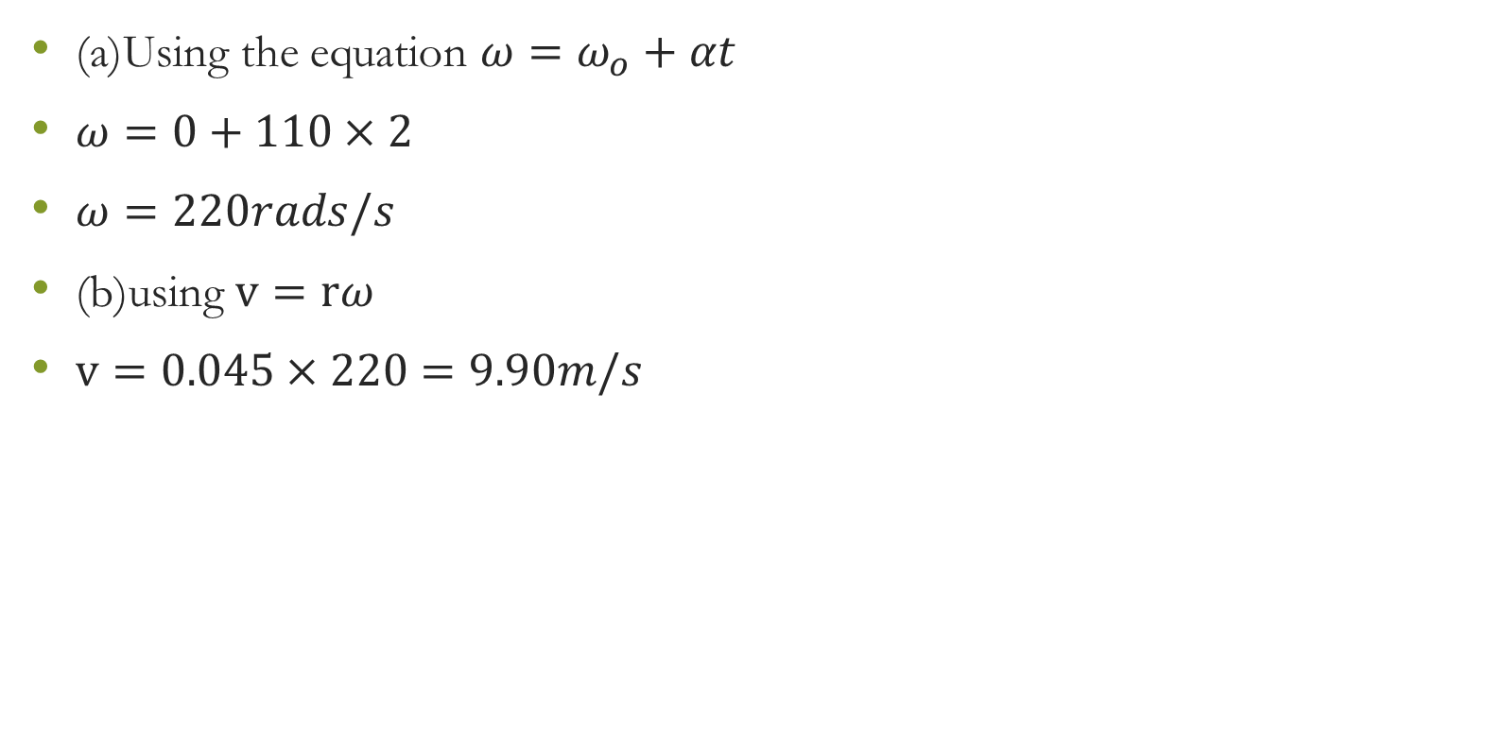
SOLUTION

Slide 12
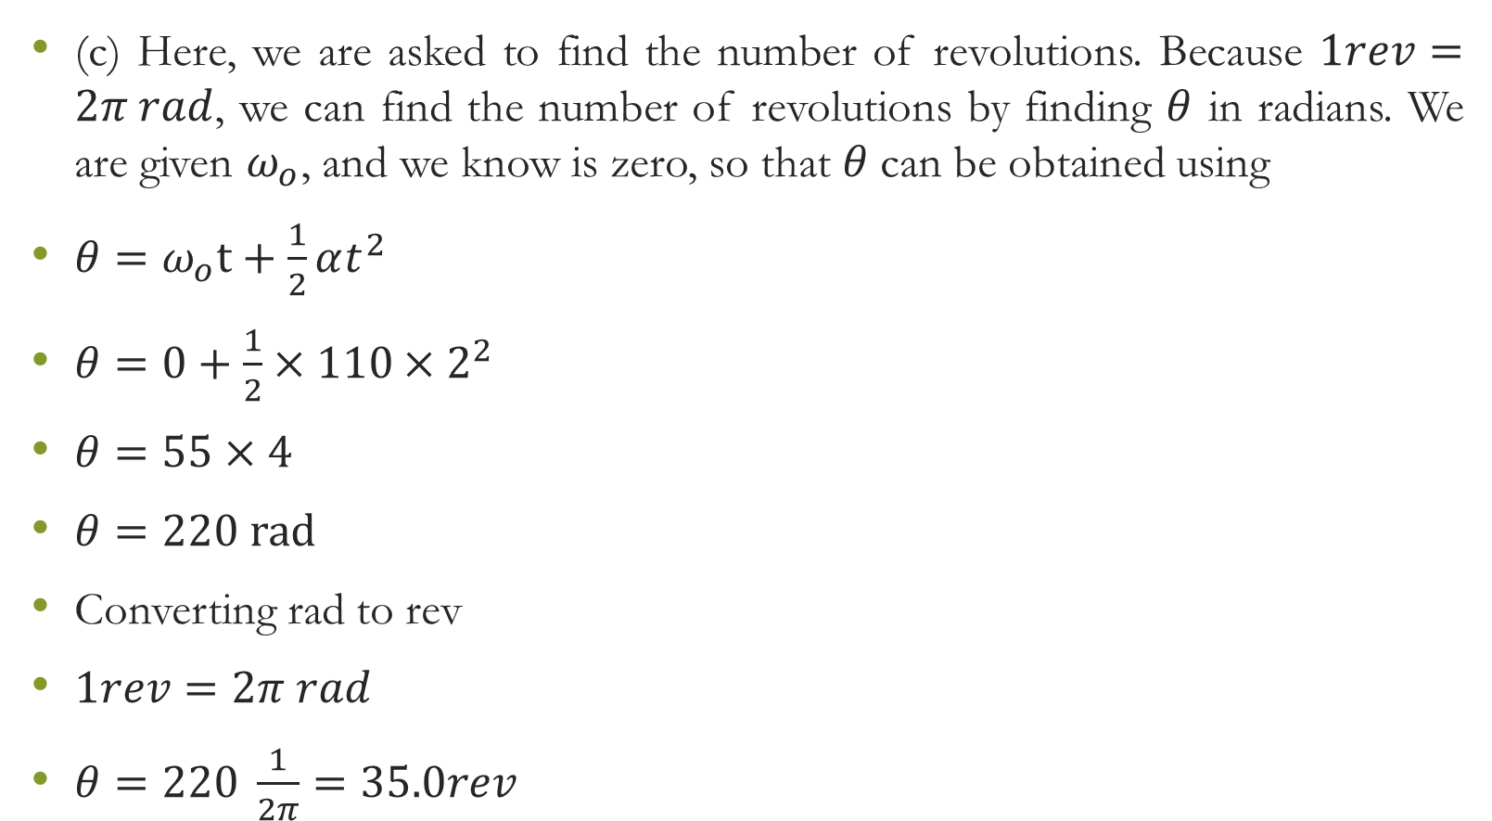

Slide 13
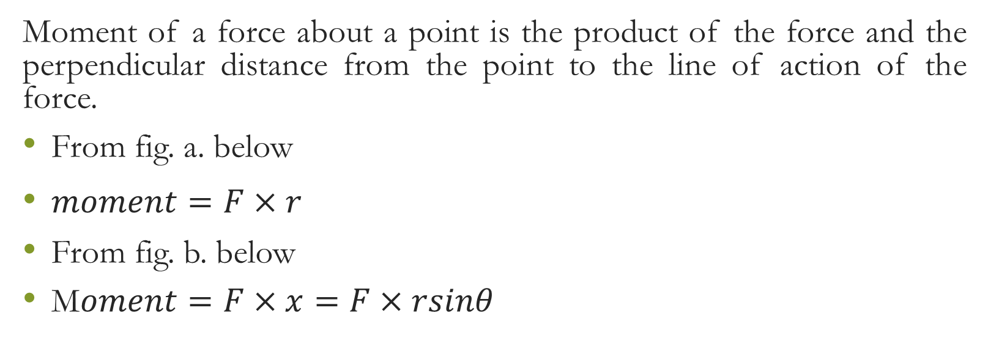
MOMENT OF A FORCE (TORQUE)

Slide 15
Centre of Gravity
The point through which the resultant weight tends to act is known as the centre of gravity

Slide 16
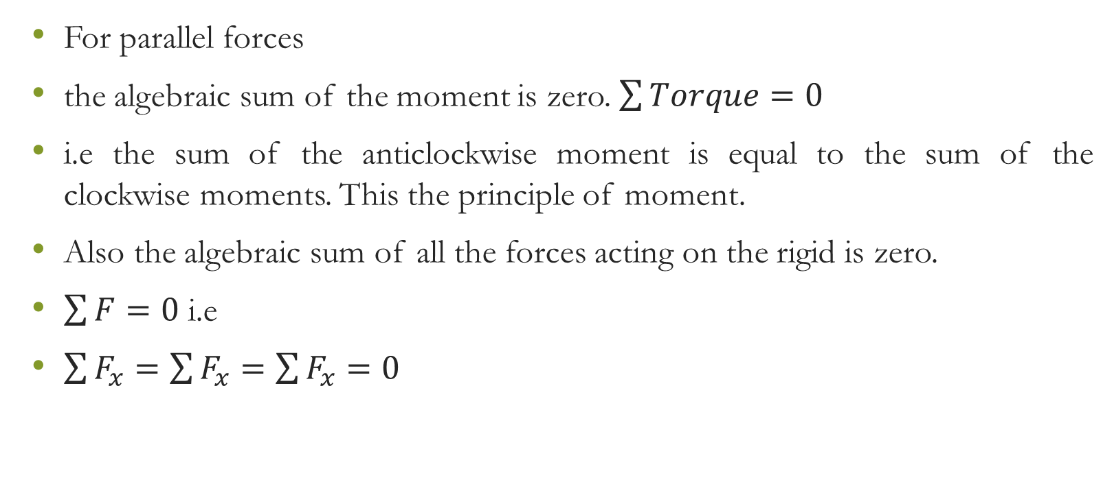
Condition for Equilibrum

Slide 17
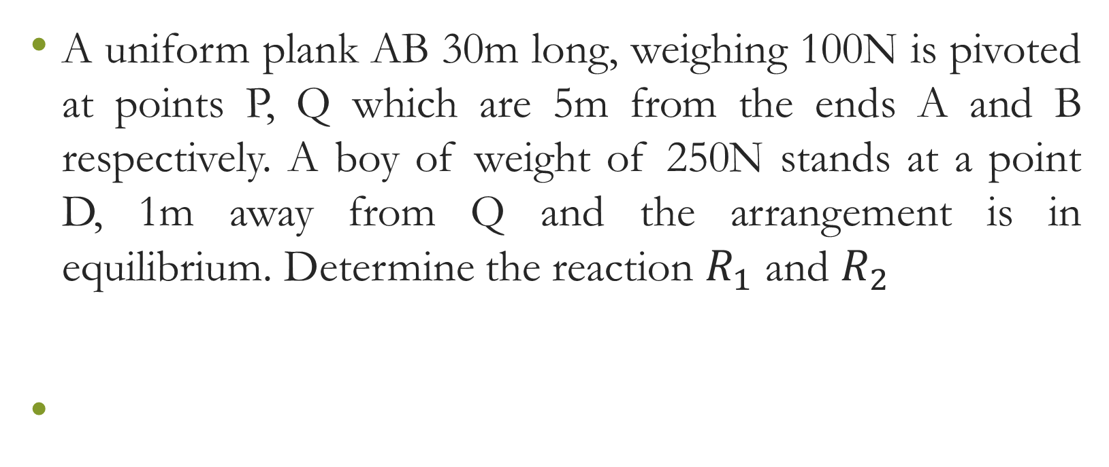
Example

Slide 19
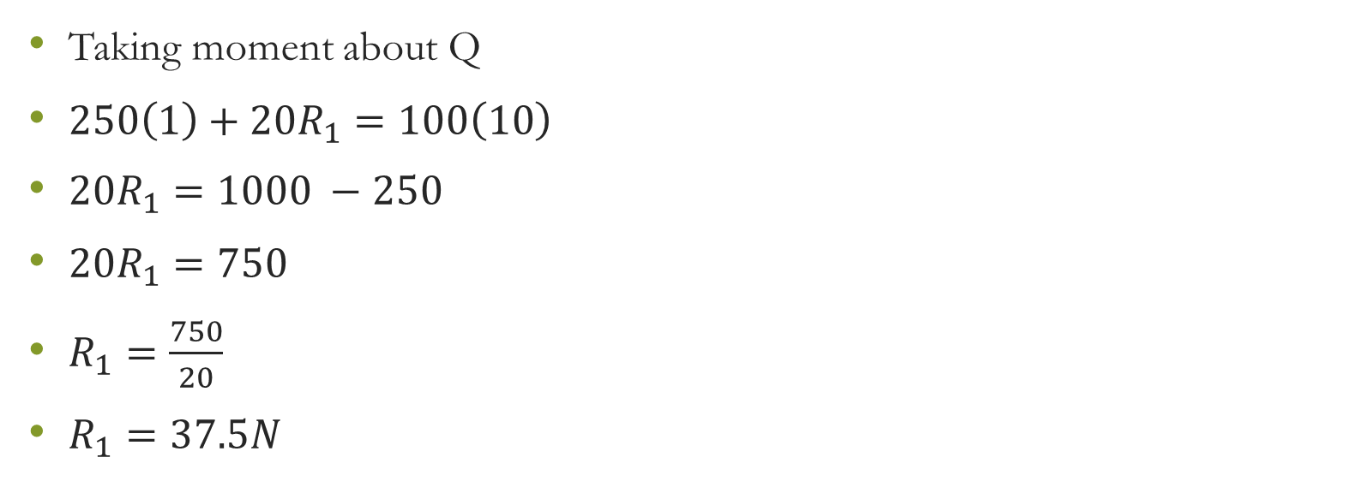

Slide 20
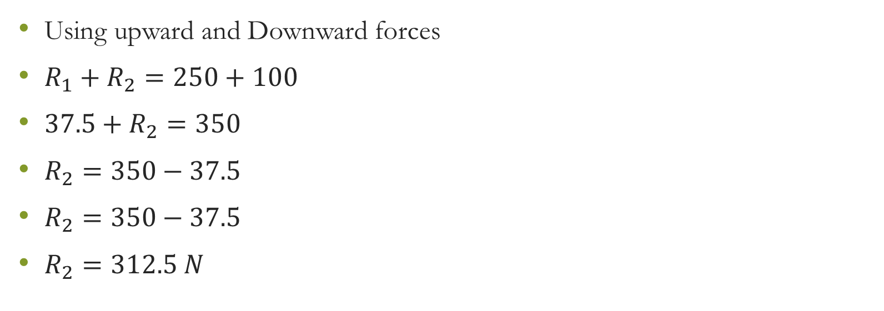

Slide 21
TRY THIS
A metre rule balances on a knife edge at the 55cm mark when a mass of 5kg is hung from the 95cm mark. Find the mass of the rule

Slide 22
Vector Multiplication
Vector multiplication can be done in two ways
Scalar or Dot product
Vector or Cross product

Slide 23
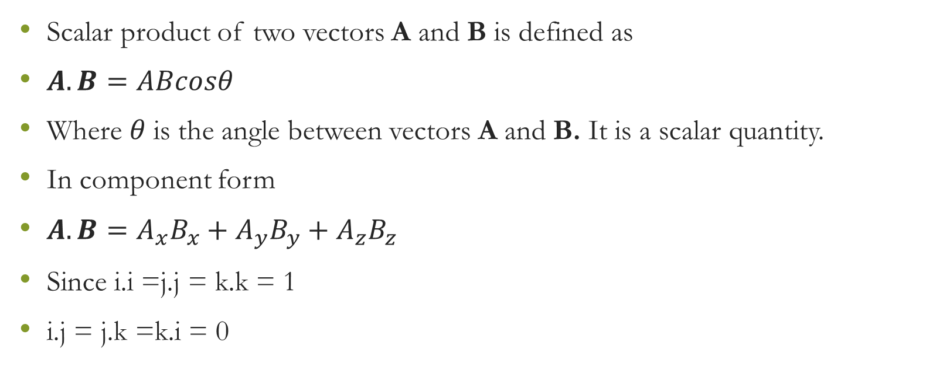
Scalar Product

Slide 24
Example
If A = 3i +4j –k and B = 2i + j + 2k. Calculate (i) A.B (ii) the angle between A and B.
Solution
A = 3i +4j –k
B = 2i + j + 2k
(i) A.B = (3i +4j –k).(2i + j + 2k)
= 3(2) + 4(1) + (-1)(2)
= 6 + 4 – 2
= 8

Slide 25
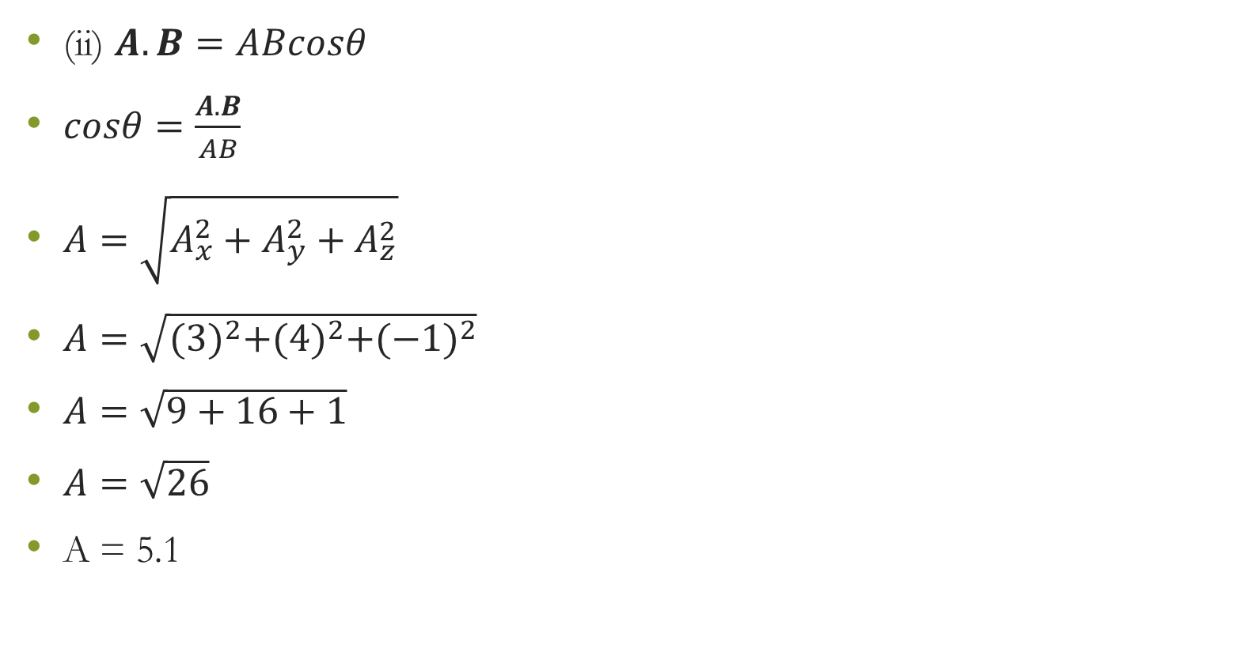

Slide 26
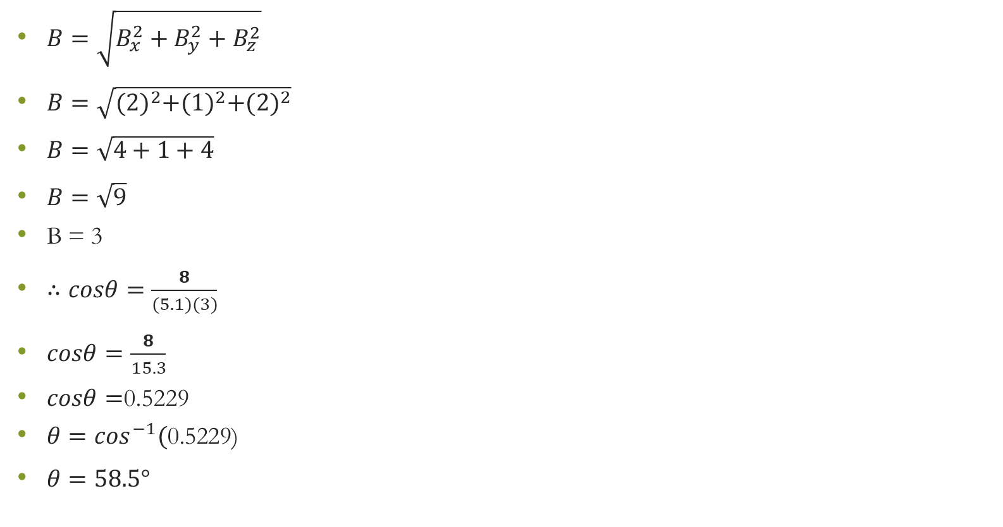

Slide 27
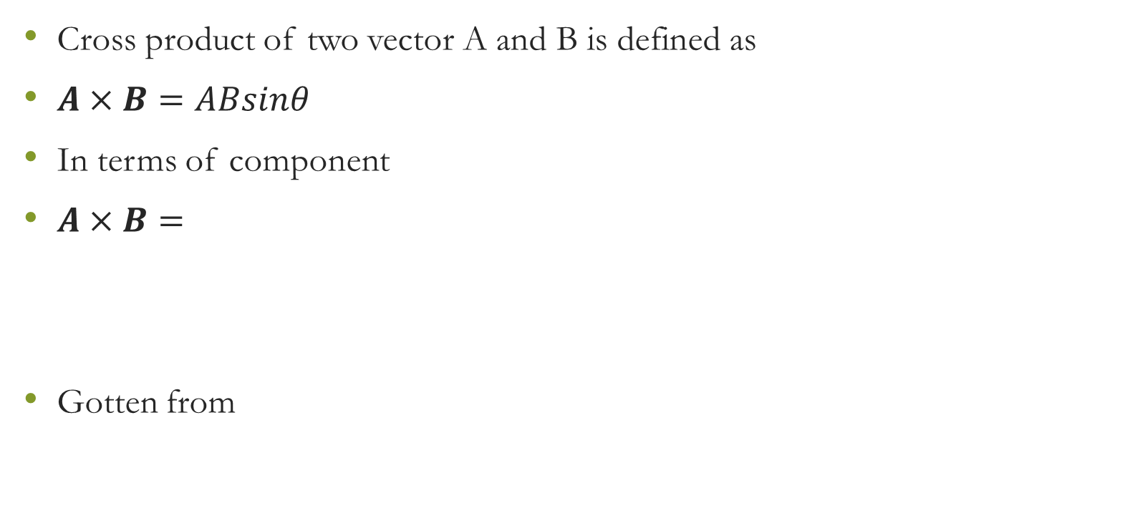
Vector Product or Cross Product

Slide 28
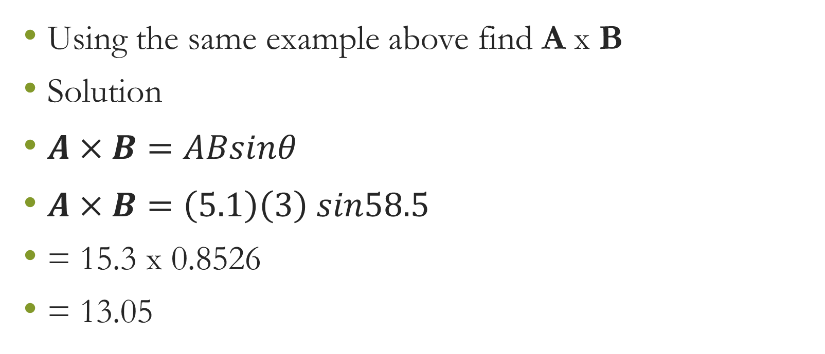
Example

Slide 29
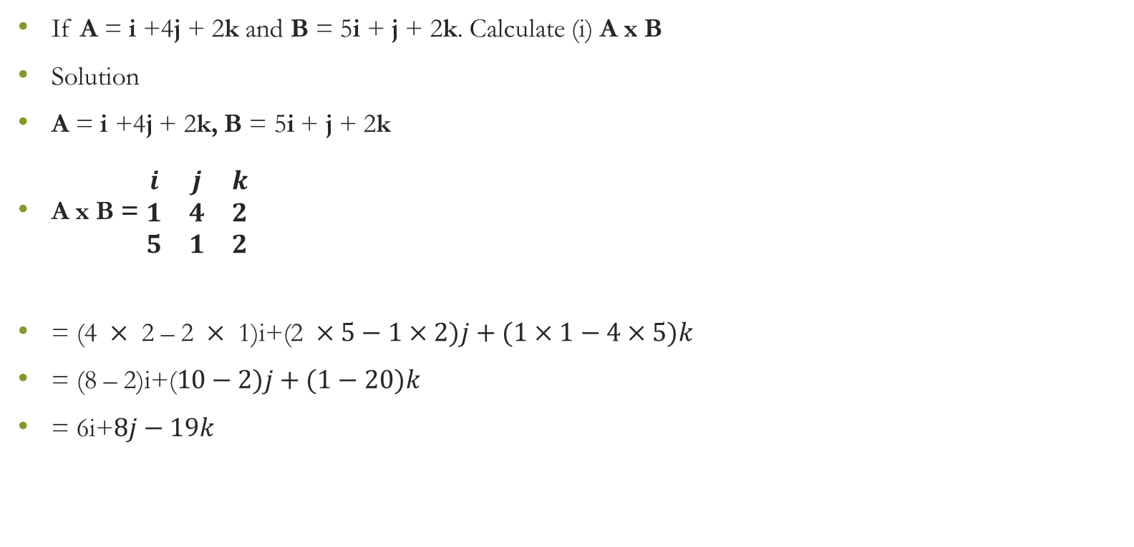
Example 2

